Slide 1
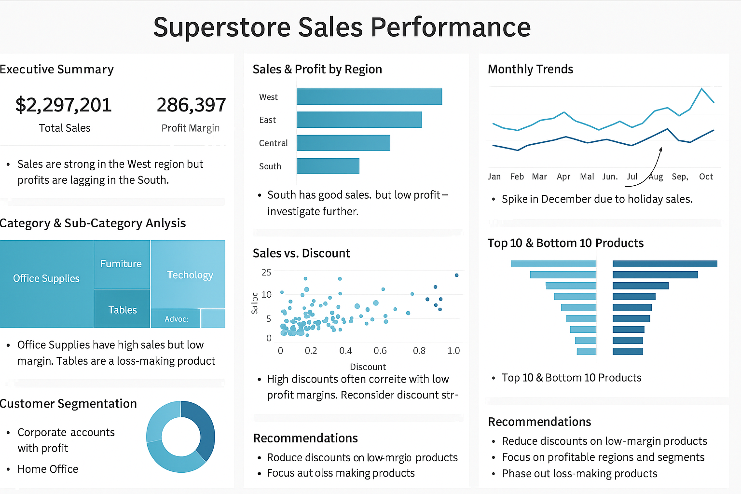
Conclusion & Recommendation
To improve profitability and performance:
Optimize Discounting Strategy – Limit high discounts on low-margin items.
Focus on High-Performing Segments – Target Corporate customers with tailored offers.
Refine Product Mix – Discontinue or reprice unprofitable sub-categories.
Strengthen Regional Strategy – Invest more in profitable states while improving logistics in underperforming ones.

Slide 2
Summary of Trends and Visual Insights
The analysis of the Global Superstore dataset revealed several key business insights through visual storytelling:
Sales and Profit are Unevenly Distributed: A few regions and product categories contribute the most to overall revenue, while others—especially some sub-categories—generate consistent losses.
High Discounts Often Hurt Profitability: Visuals show a clear negative trend between high discounts and profit margins, particularly in categories like Tables and Supplies.
Customer Segment Performance Varies: The Corporate segment emerges as the most profitable across categories, while the Home Office segment shows lower margins.
Product-Level Extremes: A handful of products account for most of the profit. However, some low-performing items with high discounts drag overall performance down.
Seasonal Sales Patterns Exist: Line charts indicate sales peaks around November and December, likely driven by holiday seasons and promotional activity.

